Slide 1
Office of the Sheriff Budget Presentation: 2023-2024
Office of the Sheriff
County of Franklin
W. Q. “Bill” Overton, Jr.
Sheriff

Slide 2
2022 Highlights
CALEA certified
School Safety Initiative
Pay Study implementation
Next Gen 911 implementation
RIOS- Interoperability radio program
Bridging the Gap expansion

Slide 3
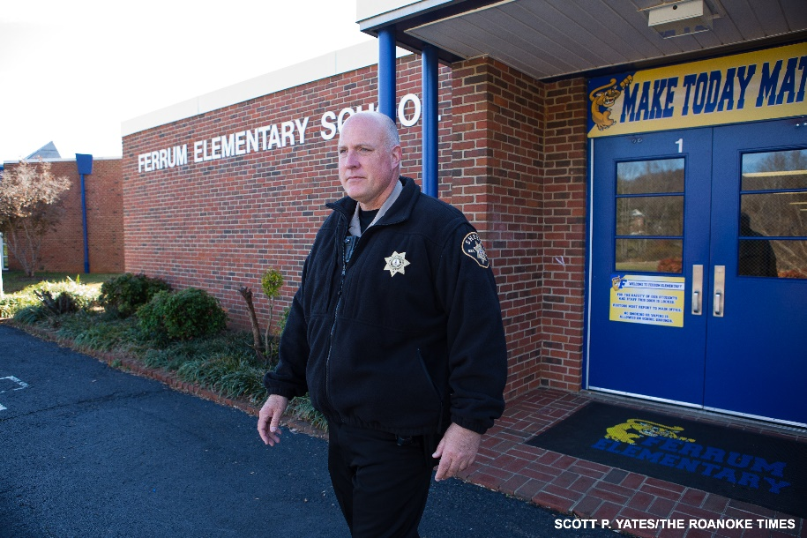
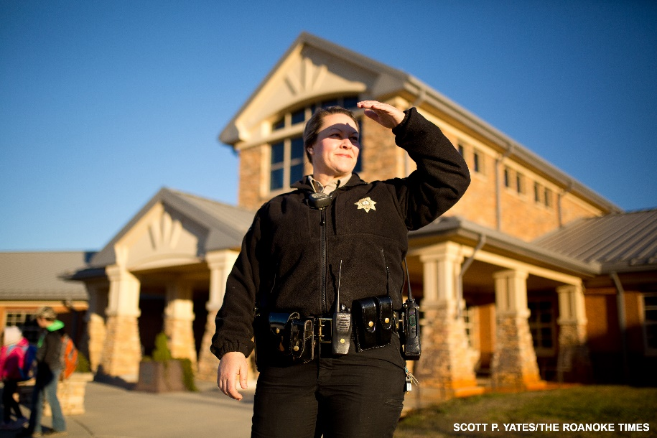
School Safety Initiative

Slide 4
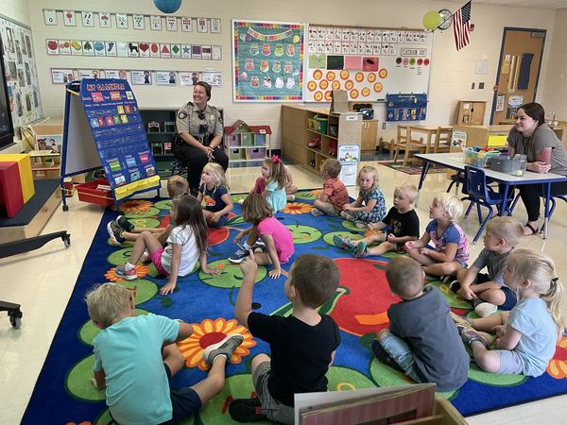
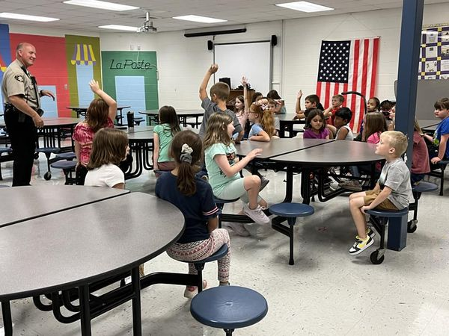
School Safety Initiative

Slide 5
Current Challenges
Recruitment and Retention
Drug abuse: Fentanyl
Potential Opioid Abatement funding
Mental Health system
Aging jail facility
Supervising/Training inexperienced
Personnel needs:
Jail Food Service Director, Evidence/Records, Jail Nurse, Investigators

Slide 6
Office of the Sheriff Budget Priorities: 2023-2024
Priorities are still driven by recruitment and retention needs.
Increasing line items due inflationary pressures
Capital Projects
Many needs, but prioritize essential projects

Slide 7
Operating Budget Request

Slide 8
Operating Budget Request
Line-item adjustments to account for inflationary increases:
Prioritized Salary/Part-time/Overtime line items
COLA 5%
General District Court increase
Maintenance service contracts
Jail Food Service
Training

Slide 9
Compensation:
Pay Study Implementation: pay study recommended yearly adjustments to keep members moving through the pay grades
State approved 5% COLA
Part-time hourly rates were not addressed in year 1

Slide 10
Compensation
Part-time hourly rates:
Sworn members: $25.00 per hour
Dispatchers: $20.00 per hour
Civilian: $15.00 minimum wage adjusted for job duties

Slide 11
Jail Food Service
The Office of the Sheriff is responsible for the custody and care of inmates housed at the Franklin County jail.
The jail was built in 1938 and is a 53- bed facility.
Robust trusty program that serves this community in litter pickup, mowing, janitorial services, and other duties.

Slide 12
Jail Food Service
Food service was privatized in 2012 in efforts to reduce cost.
Two vendors have been utilized during this span.
Food quality, portion size, and customer service are recurring issues.
Current Food service contract expired January and is now month to month.

Slide 13
Jail Food Service
We have evaluated our food service and request support to provide food service internally.
Current budget of $202,000 covers food cost, employee salaries, administrative overhead.
Vendor has advised they will be increasing by at least 8% on the next contract.

Slide 14
Jail Food Service
We will need to hire a Food Services Director that would be a county employee.
Food Services Director would be responsible for daily operations, food preparation, ordering and inventory, and compliance with health department and Department of Corrections.

Slide 15
Jail Food Service
Due to increasing food costs and overall inflationary pressures, it is difficult to get an exact budget amount.
Reviewing jail facilities that provide food service internally, our budget is comparable.

Slide 16
Jail Food Service
We would request the approval of a Jail Food Service Director position and budget increase that covers food costs and part-time staffing assistance.
At budget proposal in November, $250,000 was submitted. This amount should cover the food service and salary of the new position.

Slide 17
Capital Budget Request

Slide 18
Capital Requests
Vehicle Replacement/Upfit: $90,000 (+)
Sheriff In-car Cameras: $60,000
Radios: Mobile/Portable: $16,894
Jail Maintenance/upgrade: $125,000
Courthouse X-ray machine/metal detectors: $54,000
Tactical Vest: $25,000
Shoot House Range: $30,000
Drone Replacement: $15,000

Slide 19
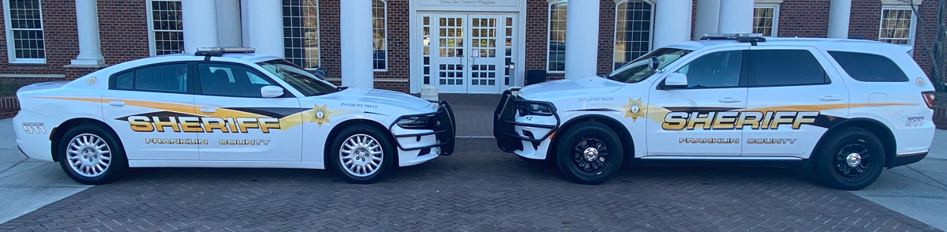
Vehicle/Replacement/Upfit
Dodge Charger
$36,000
Dodge Durango
$38,000
Upfit: $14,000
Current Budget: $450,000 Requesting: $540,000

Slide 20
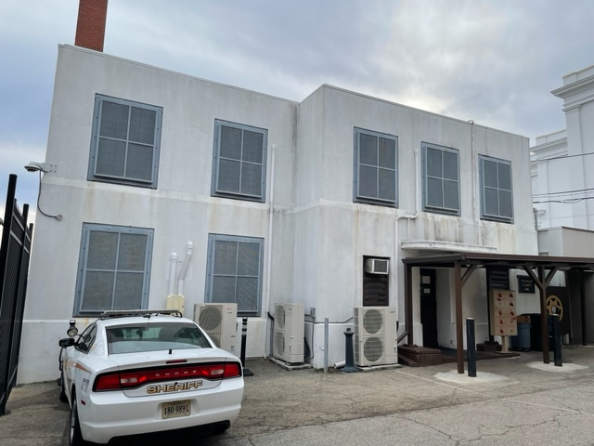
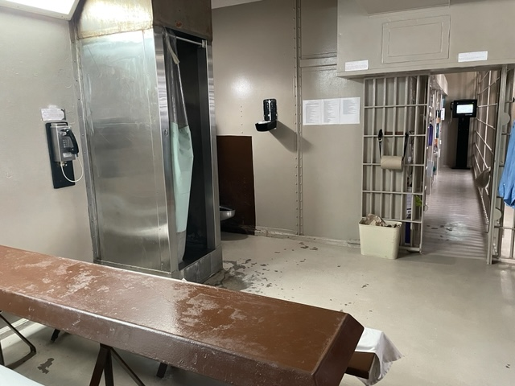
Jail maintenance/upgrade

Slide 21
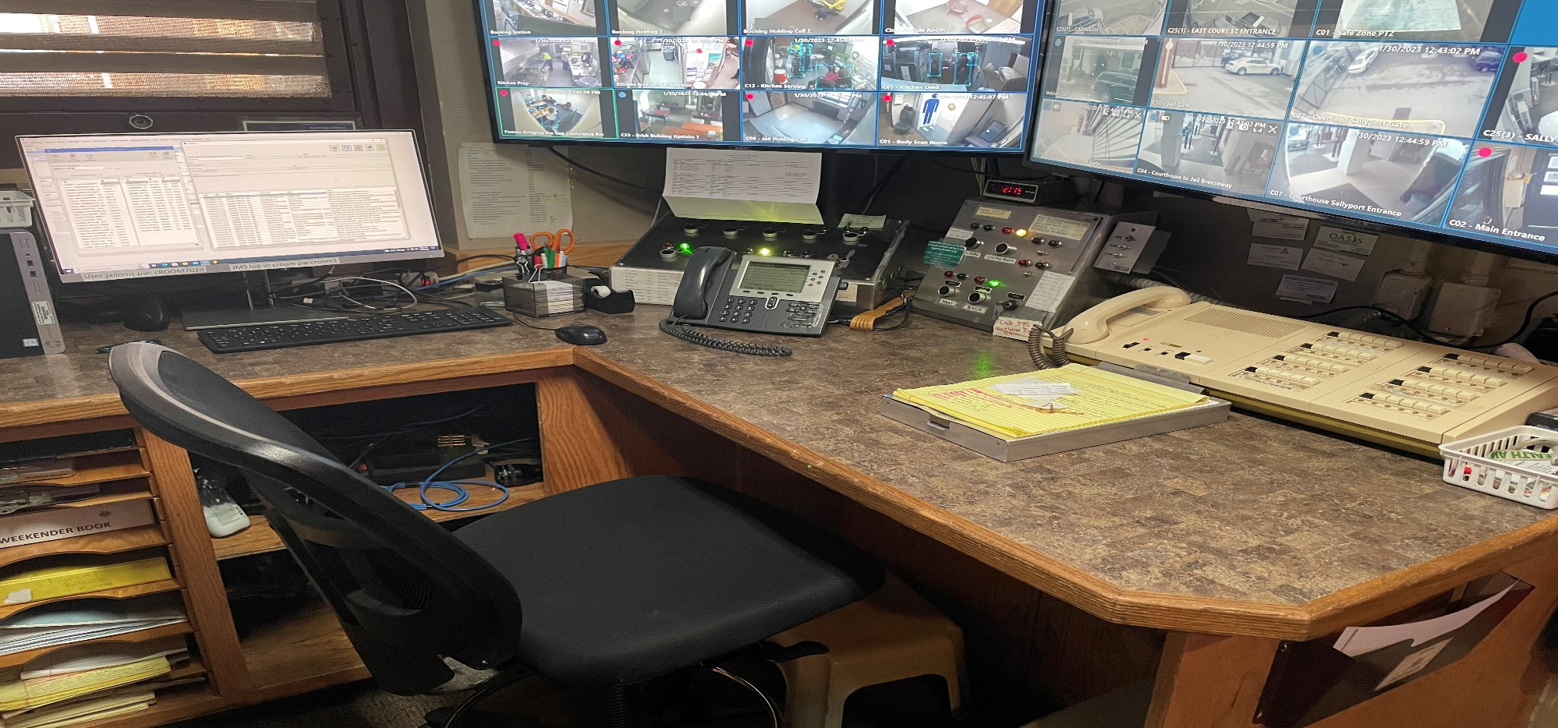
Jail Upgrades: Intercom/Door Locking
Requesting: $125,000
Intercom upgrades, door upgrades, electronic strikes

Slide 22
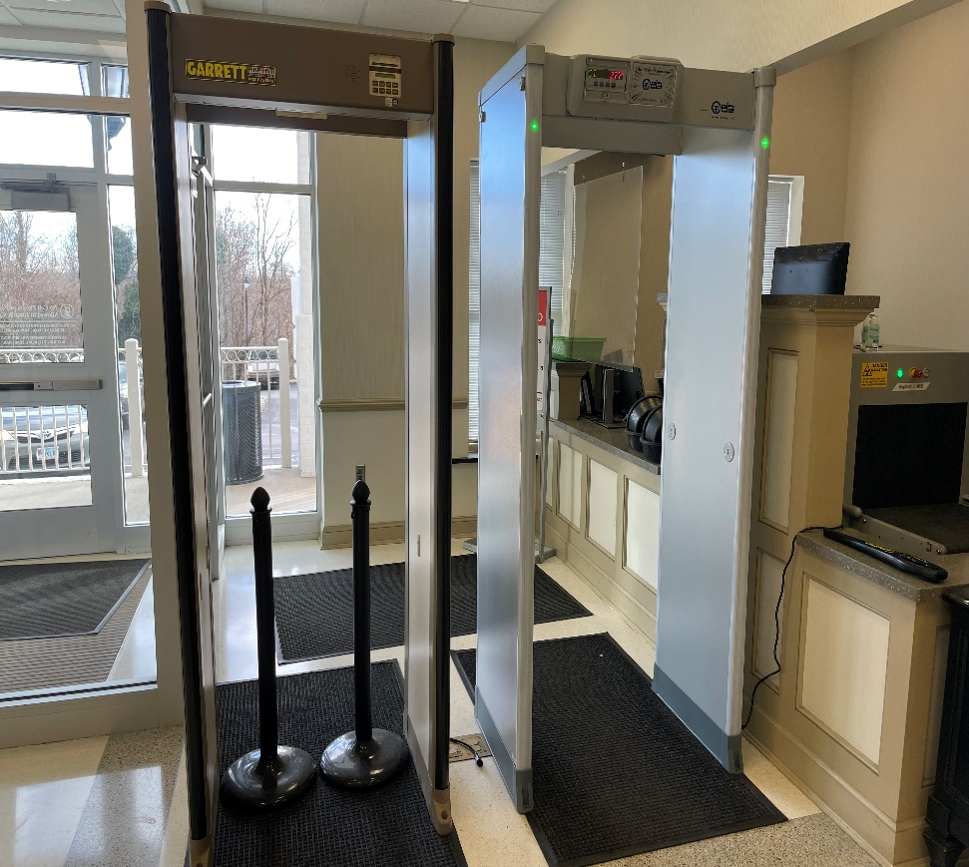
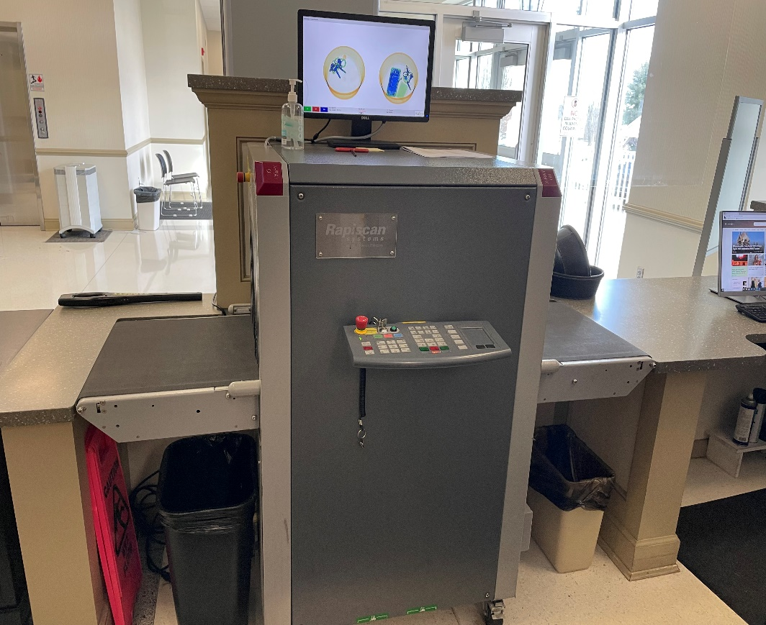
Courthouse Security
Metal Detector
$5,000
X-Ray Machine
$36,697

Slide 23
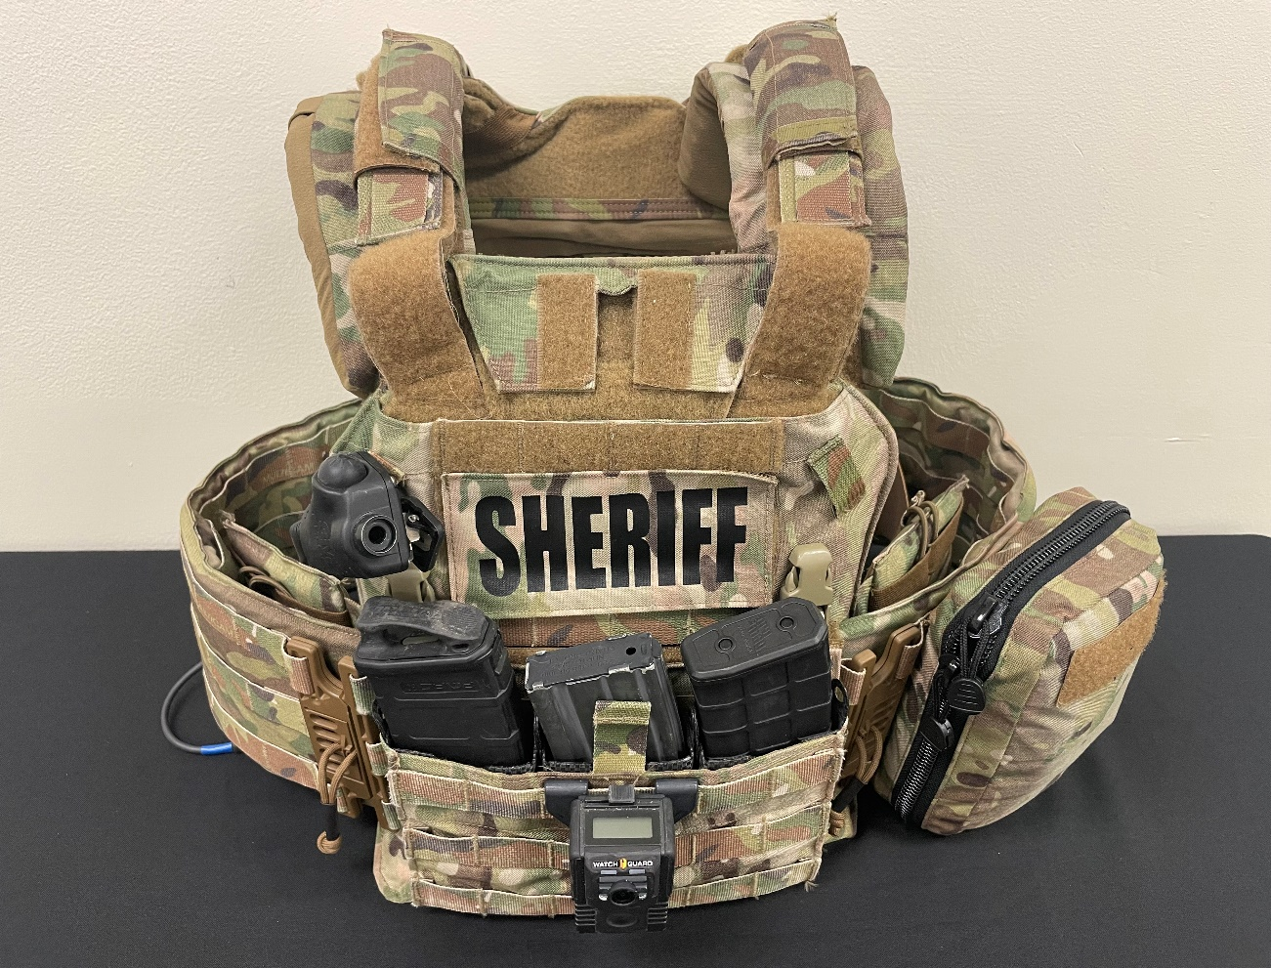
Tactical Vest
Request: $25,000

Slide 24
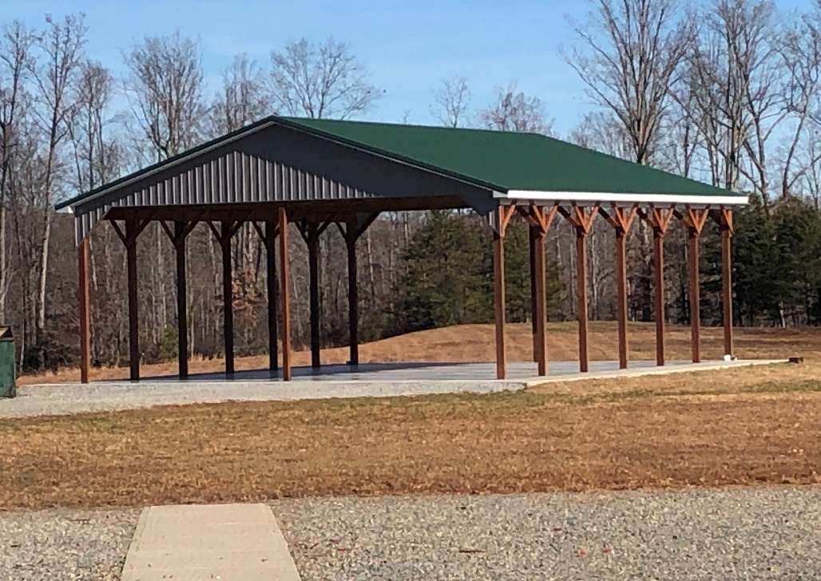
Shoot House at Range
Requesting: $30,000

Slide 25
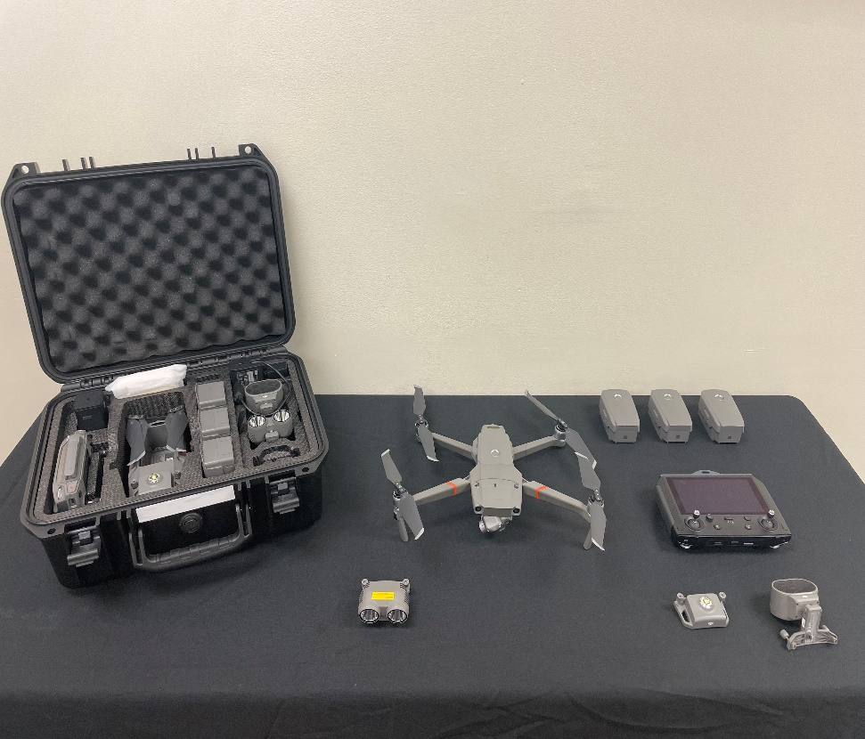
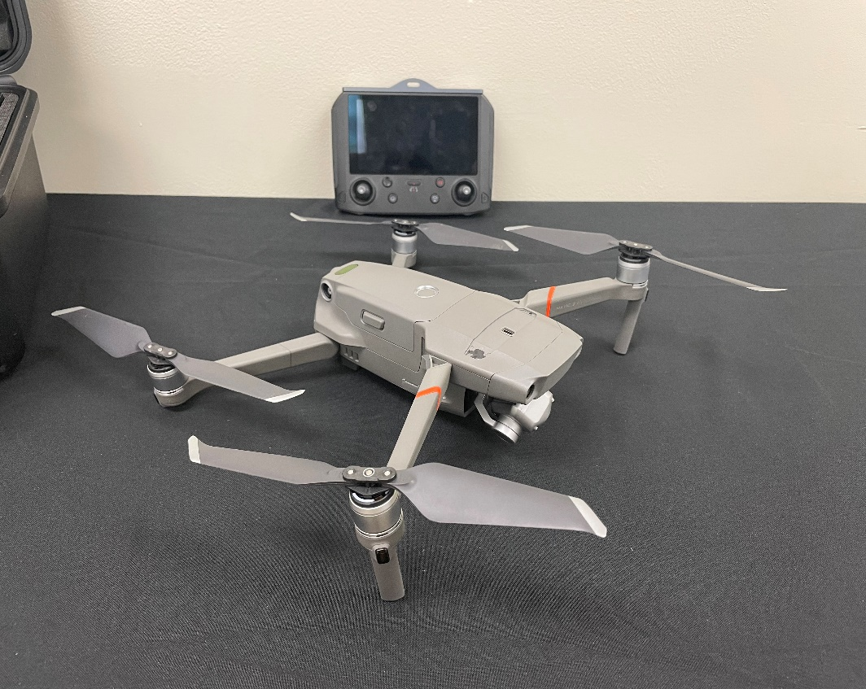
Drone Technology
Requesting: $15,000

Slide 26
Staffing Requests

Slide 27
Staffing Needs:
Jail Food Service Director
General Investigator
Narcotics Investigator
Records/Evidence position
Jail Nurse

Slide 28
Staffing Needs
Investigator: criminal investigations are more complex than ever before. Reviewing data from video surveillance, phone downloads, and computer downloads.
Narcotics: Majority of all crime is connected to drug abuse. Overdoses are at all time high.

Slide 29
Staffing Needs
Support staff- work volume continues to grow and effects support staff. Need full-time to support evidence room and records.
Property Evidence room in 2015 had 1,000 pieces. 2023 has 9,000 pieces.
Records: paper totals continue to grow each year

Slide 30
Staffing Needs
Jail Nurse: currently one of the few jails that does not have a nurse. Major concern of arrestees coming in under the influence of drugs and overdosing.
DOC says it will be required in the near future.

Slide 31
Over-hire approval
The solution to mitigate the constant state of turnover facing law enforcement is to over-hire
When someone leaves LE sworn it takes approximately one year to get back at zero
Hiring process: 3 months
Basic Academy: 6 months
Field Training: 3 months
We request the Board of Supervisors to approve the ability to over-hire two LE positions and work with finance for funding

Slide 32
School Safety Initiative: School Resource Officers
Appreciate the Boards support in approval of the SRO grant in August 2022
Our request and goal was/is to have an SRO in all elementary schools/Gereau.
Grant allowed implementation of six SRO’s in the elementary schools.
Each SRO is assigned to two schools

Slide 33
School Safety Initiative: School Resource Officers
DCJS has opened the Fiscal Year 2024 School Resource Officer Incentive Grant.
Grant application deadline is March 10, 2023.
Additional six Deputies needed for the remaining Elementary schools and one at Gereau Center.
Additional supervisor needed to manage this unit.
Request Boards continued support in protecting our children.

Slide 34
Summary
The Office of the Sheriff continues to provide quality law enforcement services to the citizens of Franklin County.
There are significant challenges facing law enforcement today.
We appreciate the Board of Supervisors support in meeting the needs of our community.

Slide 35
Questions

